Slide 1
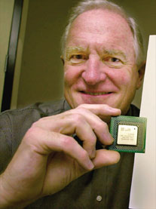
3.1 Introduction to CPU
Central processing unit etched on silicon chip called microprocessor
Contain tens of millions of tiny transistors
Key components:
  Central processing unit
  Registers
  System clock
Notes:
Also called CPU (long ago processor was spread over several boards and CPU was center unit) now all on 1 chip 1 inch square.
CPU does all maths additions/subtractions Brains of computer

Slide 2
Types of Chips
Intel makes a family of processors
  Pentium III and Pentium4 processors in most PCs
  Celeron processor sold for low-cost PCs
  Xeon and Itanium for high-end workstations and network servers
Other processors
  Cyrix and AMD make Intel-compatible microprocessors
  PowerPC chips used primarily in Macintosh computers
  HP’s Alpha microprocessor used in high-end servers
Notes:
Power PC joint developed by Motorolla IBM and Apple

Slide 3
Microprocessor Speeds
Measure of system clock speed
  How many electronic pulses the clock produces per second
  Usually expressed in gigahertz (GHz)
    Billions of machine cycles per second
    Some old PCs measured in megahertz (MHz)
Comparison of clock speed only meaningful between identical microprocessors
CPU cycle time – inverse of clock rate
Notes:
Like a heart beat – electronic pulse used for synchronising
One instruction e.g. ADD takes a number of steps/clocks and is called a machine cycle
mSec – 1/1,000, uSec – 1/1,000,000, nSec – 1/1,000,000,000, pSec etc

Slide 4
Current Technology Capabilities and Limitations
Moore’s Law
  Rate of increase in transistor density on microchips doubles every 18-24 months with no increase in unit cost
Rock’s Law
  Cost of fabrication facilities for chip generation doubles every four years
Increased packing density
Electrical resistance

Slide 5
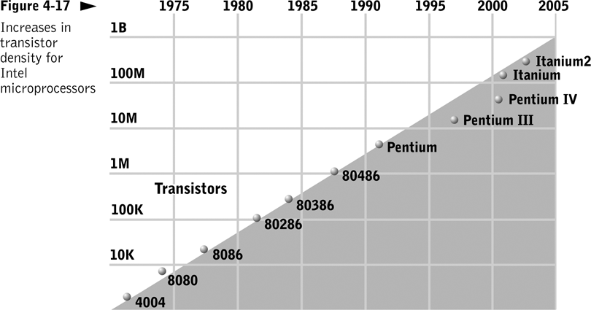

Slide 6
3.2 Components of the CPU
Control unit
  Moves data and instructions between main memory and registers
Arithmetic logic unit (ALU)
  Performs computation and comparison operations
Set of registers
  Storage locations that hold inputs and outputs for the ALU

Slide 7
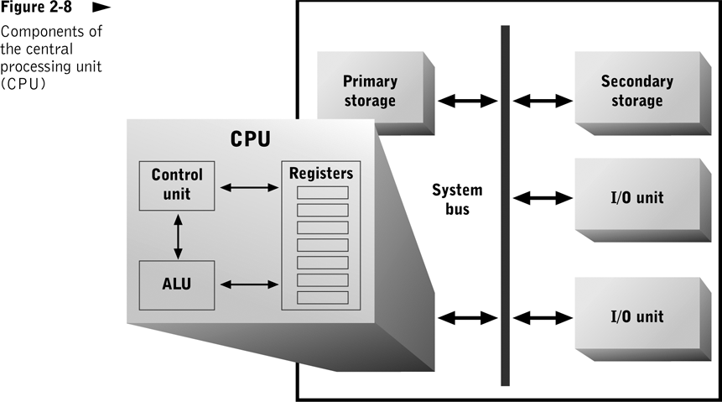

Slide 8
Actions Performed by CPU
Fetch cycle | CPU: Fetches an instruction from primary storage Increments a pointer to location of next instruction Separates instruction into components (instruction code and data inputs) Stores each component in a separate register
Execution cycle | ALU: Retrieves instruction code from a register Retrieves data inputs from registers Passes data inputs through internal circuits to perform data transformation Stores results in a register

Slide 9
CPU Registers
Primary roles
  Hold data for currently executing program that is needed quickly or frequently (general-purpose registers)
  Store information about currently executing program and about status of CPU (special-purpose registers)

Slide 10
General-Purpose Registers
Hold intermediate results and frequently needed data items
Used only by currently executing program
Implemented within the CPU; contents can be read or written quickly
Increasing their number usually decreases program execution time to a point

Slide 11
Special-Purpose Registers
Track processor and program status
Types
  Instruction register
  Instruction pointer
  Program status word (PSW)
    Stores results of comparison operation
    Controls conditional branch execution
    Indicates actual or potential error conditions

Slide 12
Word Size
Number of bits a CPU can process simultaneously
Increasing it usually increases CPU efficiency, up to a point
Other computer components should match or exceed it for optimal performance
Implications for system bus design and physical implementation of memory

Slide 13
3.3 The Physical CPU
Electrical device implemented as silicon-based microprocessor
Contains millions of switches, which perform basic processing functions
Physical implementation of switches and circuits

Slide 14
Transistors
Electronic switches that may or may not allow electric current to pass through
  If current passes through, switch is on, representing a 1 bit
  Otherwise, switch is off, representing a 0 bit
Notes:
Building block
Silicon can be altered to make these switches (Fabrication)
Semi conductor - only conducts when voltage applied
Micro contains millions of transistors

Slide 15
Switches and Gates
Basic building blocks of computer processing circuits
Electronic switches
  Control electrical current flow in a circuit
  Implemented as transistors
Gates
  An interconnection of switches
  A circuit that can perform a processing function on an individual binary electrical signal, or bit

Slide 16
Electrical Properties
Conductivity | Ability of an element to enable electron flow
Resistance | Loss of electrical power that occurs within a conductor
Heat | Negative effects of heat: Physical damage to conductor Changes to inherent resistance of conductor Dissipate heat with a heat sink
Speed and circuit length | Time required to perform a processing operation is a function of length of circuit and speed of light Reduce circuit length for faster processing

Slide 17
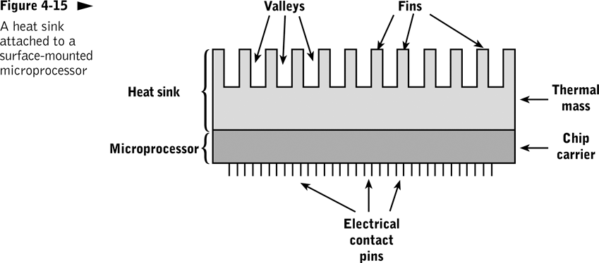

Slide 18
Processor Fabrication
Performance and reliability of processors has increased with improvements in materials and fabrication techniques
  Transistors and integrated circuits (ICs)
  Microchips and microprocessors
    First microprocessor (1971) – 2,300 transistor
    Current memory chip – 300 million transistors

Slide 19
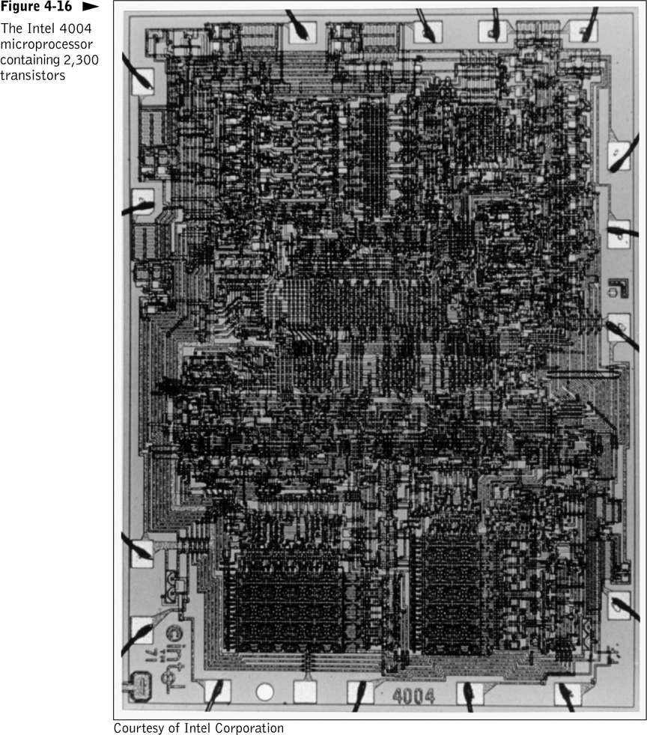

Slide 20
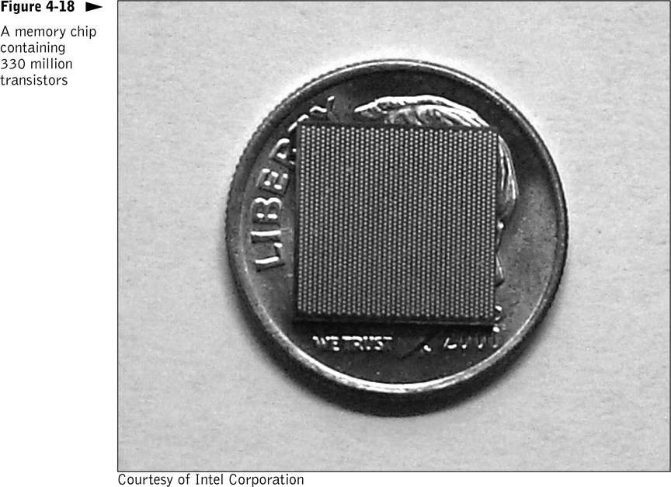

Slide 21
3.4 Future Trends
Semiconductors are approaching fundamental physical size limits
Technologies that may improve performance beyond semiconductor limitations
  Optical processing
  Hybrid optical-electrical processing
  Quantum processing

Slide 22
Optical Processing
Could eliminate interconnection and simplify fabrication problems; photon pathways can cross without interfering with one another
Eliminating wires would improve fabrication cost and reliability
Not enough economic incentive to be a reality yet

Slide 23
Electro-Optical Processing
Devices provide interface between semiconductor and purely optical memory and storage devices
  Gallium arsenide (both optical and electrical properties)
  Silicon-based semiconductor devices (encode data in externally generated laser light)

Slide 24
Quantum Processing
Uses quantum states to simultaneously encode two values per bit (qubit)
Uses quantum processing devices to perform computations
Theoretically well-suited to solving problems that require massive amounts of computation

